Slide 1


Smart Energy Meter for Domestic Usages
Mid-Review 1
Major Project
Project ID: Alpha 10(P2)
AY 2021-25
GITAM (Deemed-to-be) University
Department of Electrical Electronics and Communication Engineering
Project Team
BU21EECE0100524 Sudeep B S
BU21EECE0100553 Lakshman B H
BU21EECE0100574 Darshan D M
Project Mentor:
Dr. P Sundararaman
Project In-charge:
Ambar Bajpai
www.gitam.edu

Slide 2
Introduction
The Smart Energy Meter Project aims to transform energy consumption management by integrating advanced metering infrastructure (AMI) with real-time data analytics, enabling seamless monitoring and control in both residential and commercial settings. Equipped with IoT capabilities, the meter allows remote access to electricity usage data, providing valuable insights to both consumers and utility providers while reducing the need for manual effort. It supports dynamic pricing models, helping users optimize energy consumption by leveraging off-peak rates and lowering their bills. The system employs secure data transmission protocols to protect energy data and enhances grid resilience through predictive maintenance and timely alerts, preventing outages and ensuring a stable energy supply. With a user-friendly interface, the project empowers consumers to monitor their energy usage easily and adopt energy-saving practices, contributing to a smarter, more efficient, and sustainable energy future.

Slide 3
Objective and Goals
Objective
The primary goal of a smart energy meter for domestic usage is to provide real-time method for tracking, measuring, and controlling household energy consumption. These meters are designed to boost energy efficiency, minimize waste, and give users greater control over their electricity usage.
Real-Time Monitoring: Provides real-time data on electricity consumption to track usage.
Energy Efficiency: Helps optimize and reduce energy consumption by offering insights.
Accurate Billing: Ensures precise measurement of energy use for error-free billing.
Cost Savings: smart energy meters contribute to reducing energy bills and operational costs.
Goals
Main Goals:
Cost Savings
Accurate Billing
Additional Goals:
Smart Home Integration

Slide 4
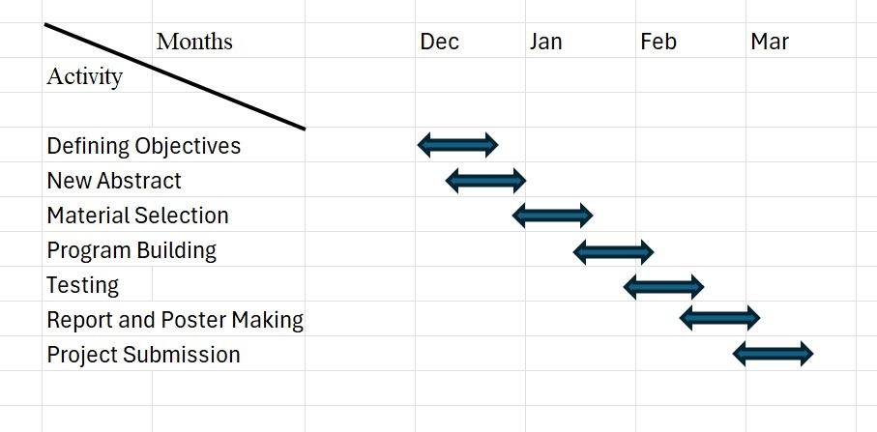
Project Plan

Slide 5
Literature Survey
SI NO | Title of the Paper (research paper) | Year | Author | Key Findings | Research gap
1. | DESIGN AND IMPLEMENTATION OF SMART ENERGY METER | 2022 | V. Preethi and G. Harish | Technology Utilization: The smart energy meter design leverages IoT technology, particularly using microcontrollers and wireless communication modules, to enable remote monitoring and management of energy consumption. Real-Time Monitoring: The system allows for real-time energy monitoring, providing both consumers and utility providers with accurate and up-to-date information about energy usage, which can help in optimizing consumption and managing energy distribution more efficiently Implementation Challenges: The document discusses various challenges encountered during the implementation, such as hardware-software integration, ensuring data security and privacy, and managing the cost of deploying such systems on a large scale. | Cost Concerns: The initial cost of deploying smart meters, including the cost of hardware, installation, and maintenance, is identified as a significant barrier, especially in regions with limited financial resources. Data Management and Security: The document points out the need for improved data management practices and enhanced security measures to protect the large volumes of data generated by smart meters from cyber threats.

Slide 6
Literature Survey
SI NO | Title of the Paper (conference paper) | Year | Author | Key Findings | Research gap
2. | ARDUINO BASED SMART ENERGY METER USING GSM | 2021 | Himanshu K. Patel and TanishMody | The project aims to create a smart energy meter that monitors electricity usage in real time and sends data to users through GSM technology. an Arduino microcontroller reads the energy data, which is then transmitted via SMS using a GSM module. The system also notifies users about their consumption, including high usage alerts, helping them manage energy more efficiently. | The system focuses on basic energy monitoring and SMS notifications but does not explore advanced features such as remote disconnection, IoT integration, or detailed consumption analytics. Additionally, while it aims to monitor energy usage, the project does not address optimizing the energy efficiency of the system itself, particularly regarding the energy consumption of the GSM module and Arduino.
3. | DESIGN, IMPLEMENTATIONAND DEPLOYMENT OF AN IOT BASED SMART ENERGY MANAGEMENT SYSTEM | 2019 | M. Usman saleem , m. Rehan usman , and mustafa shakir | The Smart Energy Management System (SEMS) integrates IoT devices, a central server, and a user interface to monitor and manage energy consumption. User interaction is enabled via a mobile application, while communication between devices and the cloud is ensured through reliable protocols like MQTT and HTTP. | The document briefly touches on the use of IoT devices and cloud computing but lacks in-depth discussion of the security and privacy concerns associated with the system. Additionally, it does not include a cost-benefit analysis, leaving the economic feasibility of large-scale deployment unexplored. Future research could focus on evaluating the costs of IoT devices, cloud services, and ongoing maintenance to assess its practicality.

Slide 7
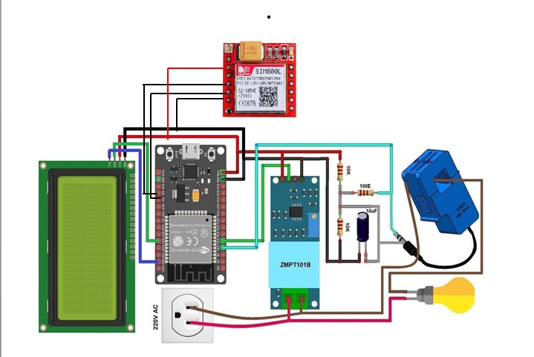
Architecture(In-Progress)

Slide 8
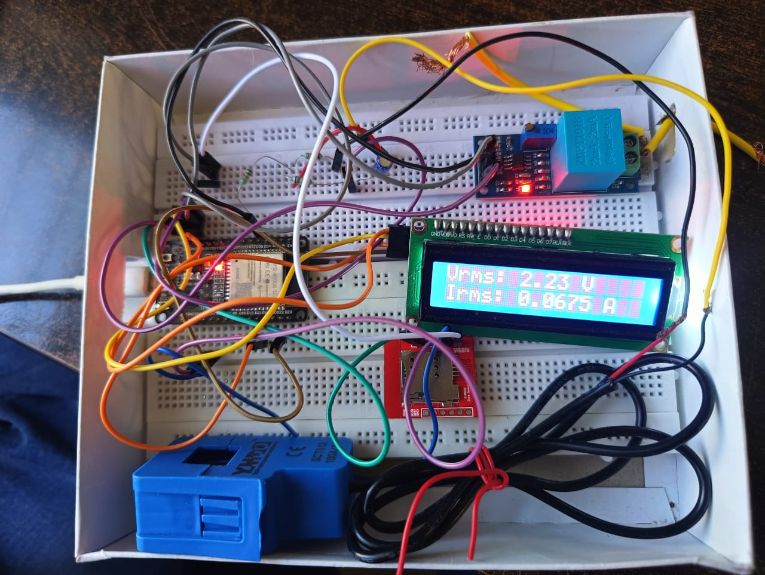
Implementation and Results – Iteration 1
Iteration : Results + Validation against the use cases and test cases

Slide 9
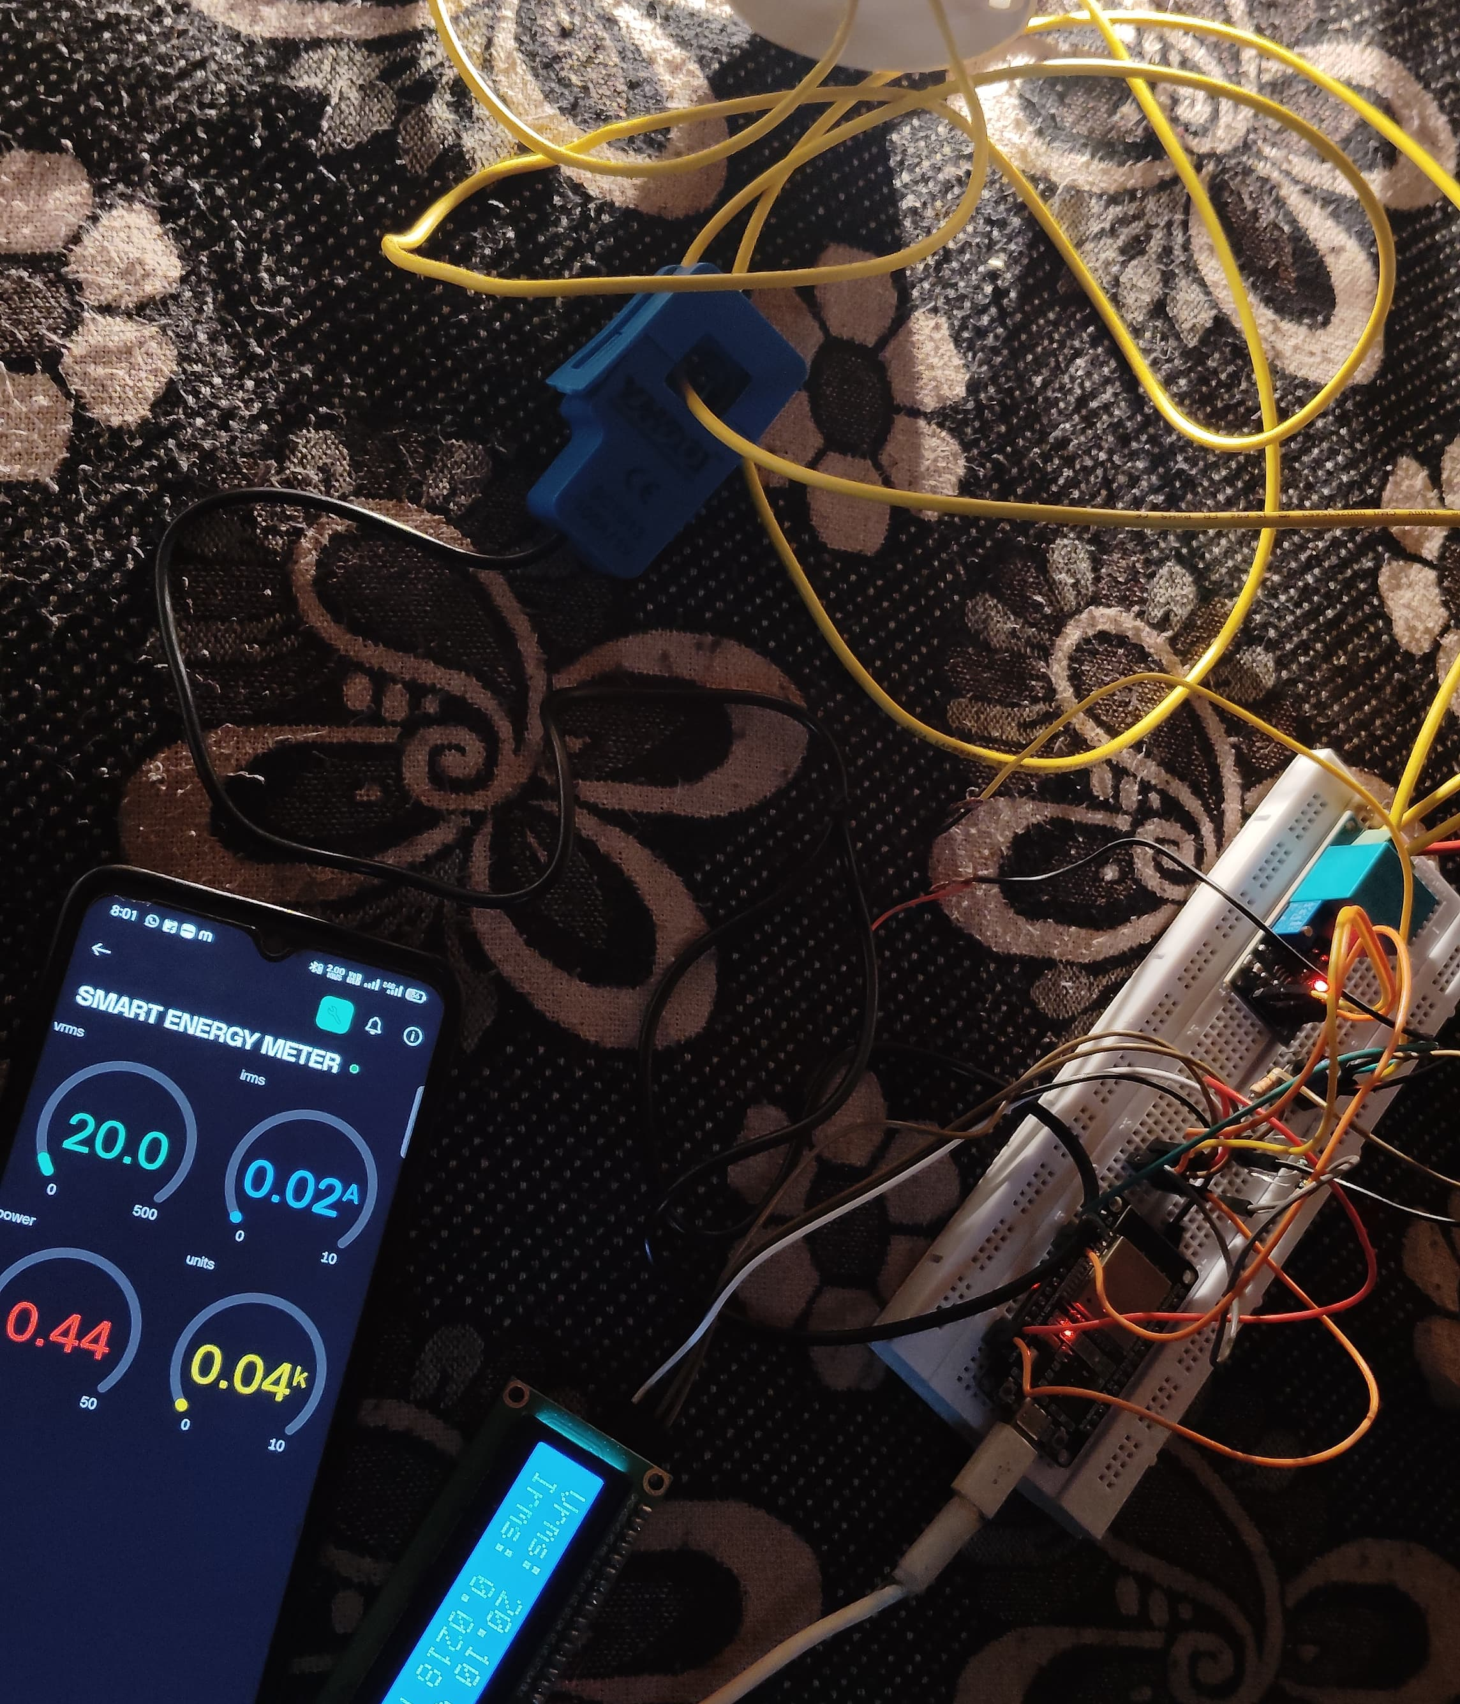
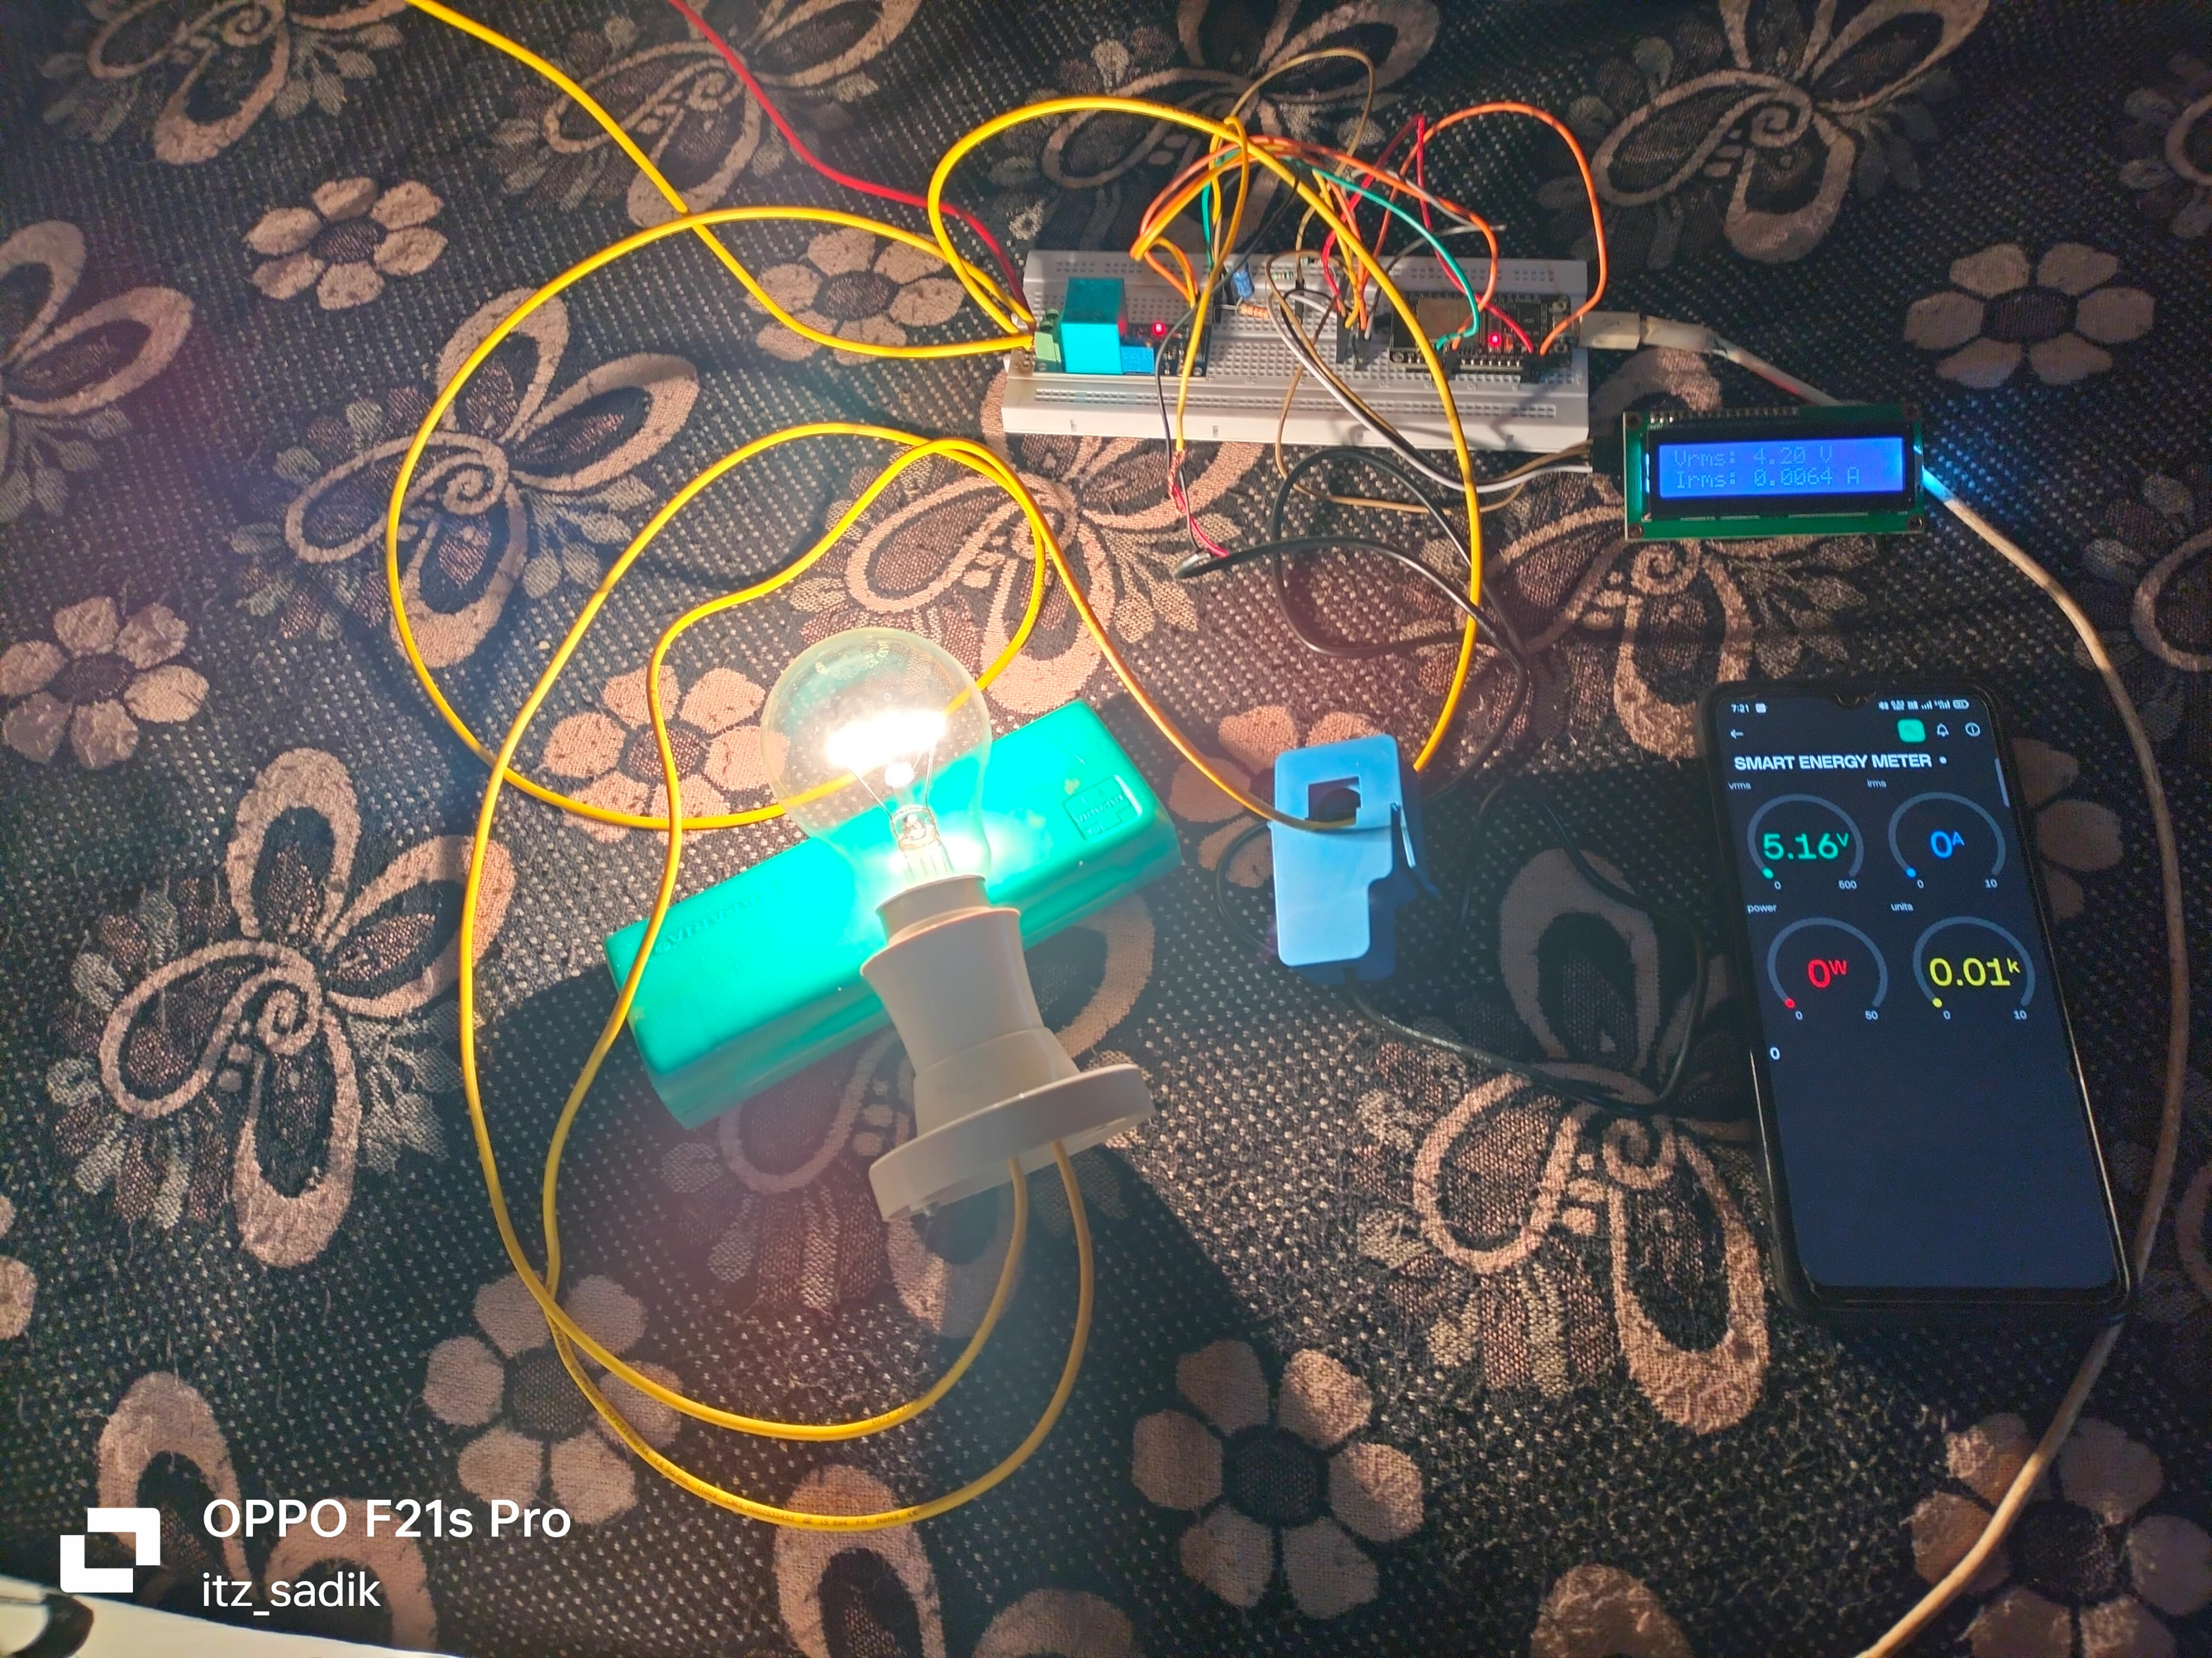
Implementation results

Slide 10
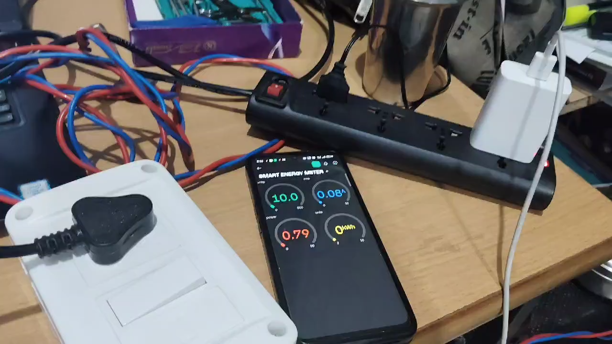

Slide 11
Contribution
Team Progress and Movement
Planning and Research
Hardware Development
Testing and Validation
Documentation and Reporting
Movement:
Interactive sessions with project guide.
Group discussions.
Individual Contribution
Key contributions: Sudeep B S
Prototype design
Coding (combined working)
Key contributions: Lakshman B H
Purchasing components
Final PPT and Report
Key contributions: Darshan D M
Block diagram
Hardware setup
11

Slide 12
Conclusion & Future Work
Summary and Conclusion :
The Smart Energy Meter using successfully modernizes traditional energy metering by enabling real-time monitoring, accurate billing. It empowers consumers to track and manage their electricity usage more efficiently while providing utility providers with better control, reducing human error and less Human Effort.
Future Work:
IoT platform integration for cloud-based monitoring and data storage.
Mobile app to enable users to control energy usage from anywhere.
Creating a Smart Energy system to display how much electricity is consumed and the bill.
Enabling the system to send electricity consumption data to the power station.
Ensuring the device retrieves data even when it is disconnected

Slide 13
THANK YOU
Have a Great Day !

